Slide 1



FIRE BREATHING ROBOT
Guide: Mr. Ananda sarvanan
Team:
B.Mukesh Kumar – VTU 6569
V. Sai Nishanth – VtU 6186
R. Raj Kumar – VtU 6084

Slide 2
Project Objective:
In the event of a fire breakout, to rescue people and to quench the fire we are forced to use human resources which are not safe.
The main motto of our project is to detect the fire and quench the fire
Flames (Match stick lights) must be tracked and found in the robot path and extinguished.

Slide 3
Block Diagram:
Micro Controller
Sensor Unit
Motor Driving Unit
Water Pumping Unit

Slide 4
Literature Review:
I.
H. P.Singh, Akanshu Mahajan, N. Sukavanam, Veena Budhraja, Swarn Singh, Amit Kumar and Anadi Vashish, “Control Of An Autonomous Industrial Fire Fighting Mobile Robot” , DU Journal of Undergraduate Research and Innovation (Nov-2015).
1.The paper describes the construction and design of mobile fire fighting robot. The system contains two optically isolated D.C. motors. Robot performs analog to digital conversion of the data provided by infrared sensors.
2.Five infrared sensor are used. Two sensors control the motion of the robots and three are for flame detection. The extinguisher comprises of D.C water pump and a water container.

Slide 5
Swati A. Deshmukh, Karishma A. Matte And Rashmi A. Pandhare, “Wireless Fire Fighting Robot”, International Journal For Research In Emerging Science And Technology, Volume-2, Special Issue-1, March-2015.
II.
The fire fighting robot can move in both forward and reverse direction and can turned in left and right directions. Thus fire fighter can operate the robot over a long distance and there is no need for human near the area on fire.
Light dependent resistors are used for detection of fire. These resistors are highly sensitive devices and are capable of detecting very small fire.
The robot provides security at home, buildings, factory and laboratory. It is an intelligent multisensory based security system which contains fire fighting system in daily life

Slide 6
Manish Kumbhare, S S Kumbhalkar, Ratnesh Malik. “FIRE FIGHTING ROBOT: AN APPROACH”,Vol.2,Issue.II/March 12, pp.1-4, Indian Streams Research Journal (2014).
III.
This paper covers the design and construction of a robot that is able to extinguish fire. this robot fully autonomous and implements the following concepts: environmental sensing and awareness, proportional motor control.
This robot processes information from its various sensors and key hardware elements via microcontroller.
It uses Ultraviolet, Infrared and visible light to detect various components of its environment.

Slide 7
IV.
Sahil S.Shah, Vaibhav K.Shah, Prithvish Mamtora And Mohit Hapani, “Fire Fighting Robot”, International Journal Of Emerging Trends & Technology In Computer Science (IJETTCS), Volume 2, Issue 4, July – August 2013.
IT comprises of making the robot follow a black strip. This was done using a comparator circuit using the LDR whose reference voltage was fixed using the potentiometer.
In our case, the light reflected from the white surface is more than that from the black surface.
If the black surface come under one of the two LDR’s the motor corresponding to that LDR stops, the other making it move away from the black line

Slide 8
FLOW CHART:
Start
Getting input from sensors
A
If Left sensor detects
If middle sensor detects
If Right sensor detects
Right Motor Runs
Both Motor Runs
Left Motor Runs

Slide 9
Rotate Servo Motor clock wise & Anti-Clock wise
Spraying Water from the pump
Input sensing
yes
A
NO
End

Slide 10
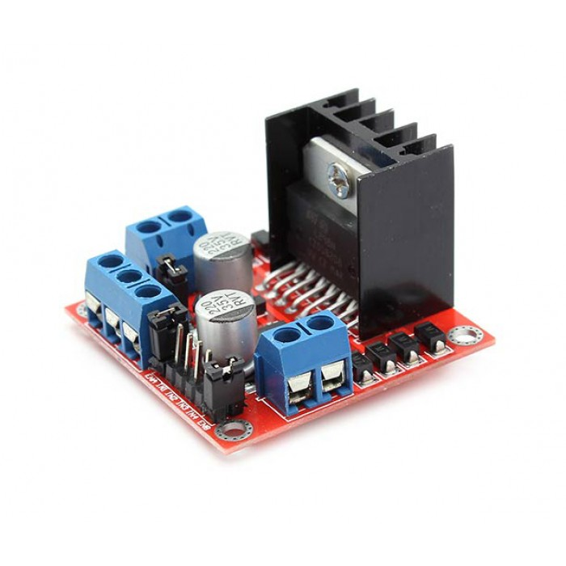
L298N Motor Driver –
Logical Voltage: 5V.
Drive Voltage: 5V-35V.
Logical Current: 0-36mA.
Drive current: 2A (MAX single bridge)
Max Power: 25W.
Dimensions: 43 x 43 x 26mm.
Weight: 26g.
L298N MOTOR DRIVER

Slide 11

X3301 Multispectrum Infrared Flame Detector
SPECIFICATIONS
Certified​d to 81 meters / 265 feet
​​Broadest range of supported fuel types​
​Automatic fail-safe checks every 60 seconds
Greatest Field of View

Slide 12
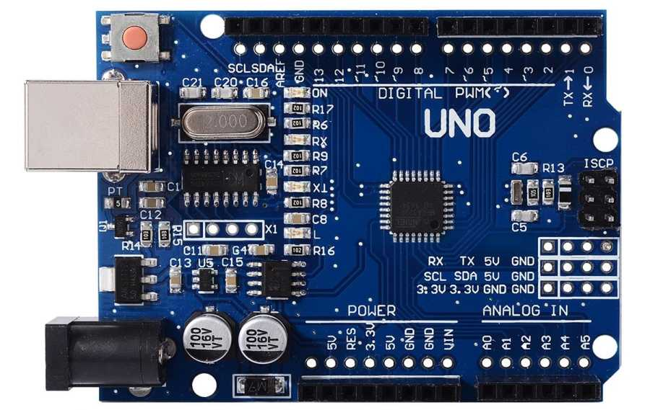
AURDINO UNO
Features:
14 Digtal pins
5 analog pins
32 kb flashmemory
2 kb ram.
16 MhZ Crystal oscillator
On board Reset Button

Slide 13
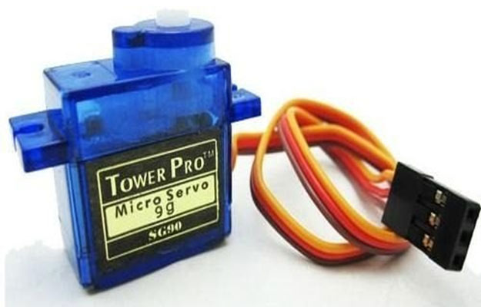
SERVO MOTOR:
Size: 32 × 11.5 × 24mm (Include tabs) 23.5 × 11.5 × 24mm (Not include tabs)
Weight: 8.5g (Not include a cable and a connector) 9.3g (Include a cable and a connector)
Speed: 0.12sec/60degrees (4.8V) 0.10sec/60degrees (6.0V)
Torque: 1.5kgf-cm (4.8V) 2.0kgf-cm (6.0V)
Voltage
4.8V-6.0V
Connector type: (Yellow: Signal, Red: VCC, Brown:GND)

Slide 14
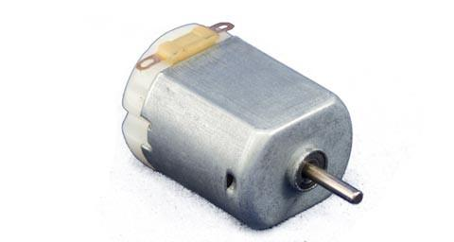
DC MOTOR
Specifications:
RPM: 300
Voltage: 4V to 12V
Shaft diameter: 6mm
Shaft length: 22mm
Gear assembly: Spur
Brush type: Carbon
Motor weight: 143gms

Slide 15
Working of DC Motor
A motor is an electrical machine which converts electrical energy into mechanical energy. The principle of working of a DC motor is that "whenever a current carrying conductor is placed in a magnetic field, it experiences a mechanical force".

Slide 16
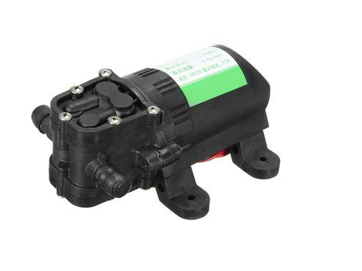
DC Motor Pump
FEATURES:
Electric Voltage: 12V DC Maximum current: 2.0A
Lift: 4-5 meters
Operating voltage:12 v

Slide 17
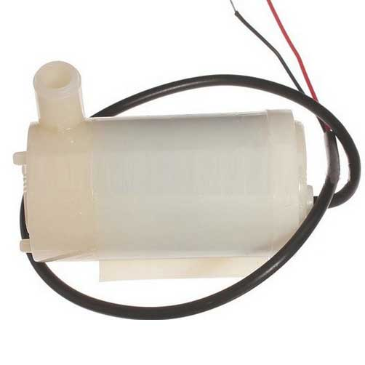
WATER PUMP used:
Product Description:
Operating Voltage 5V
current consumption: <200mA
Weight: 0.1Kg
output: Approx 50L/h H-max: 0.1m

Slide 18
Working of Water Pump:
The most common water pumps use a spinning disk with impellers to rotate the water inside a chamber. Impellers are just a blade that extends from the disk to contact and push the water.
This spinning of the water inside the chamber will result in forces that forces the water to move toward the chamber walls. This force pushes the water out through an exhaust port on the chamber outer wall.

Slide 19
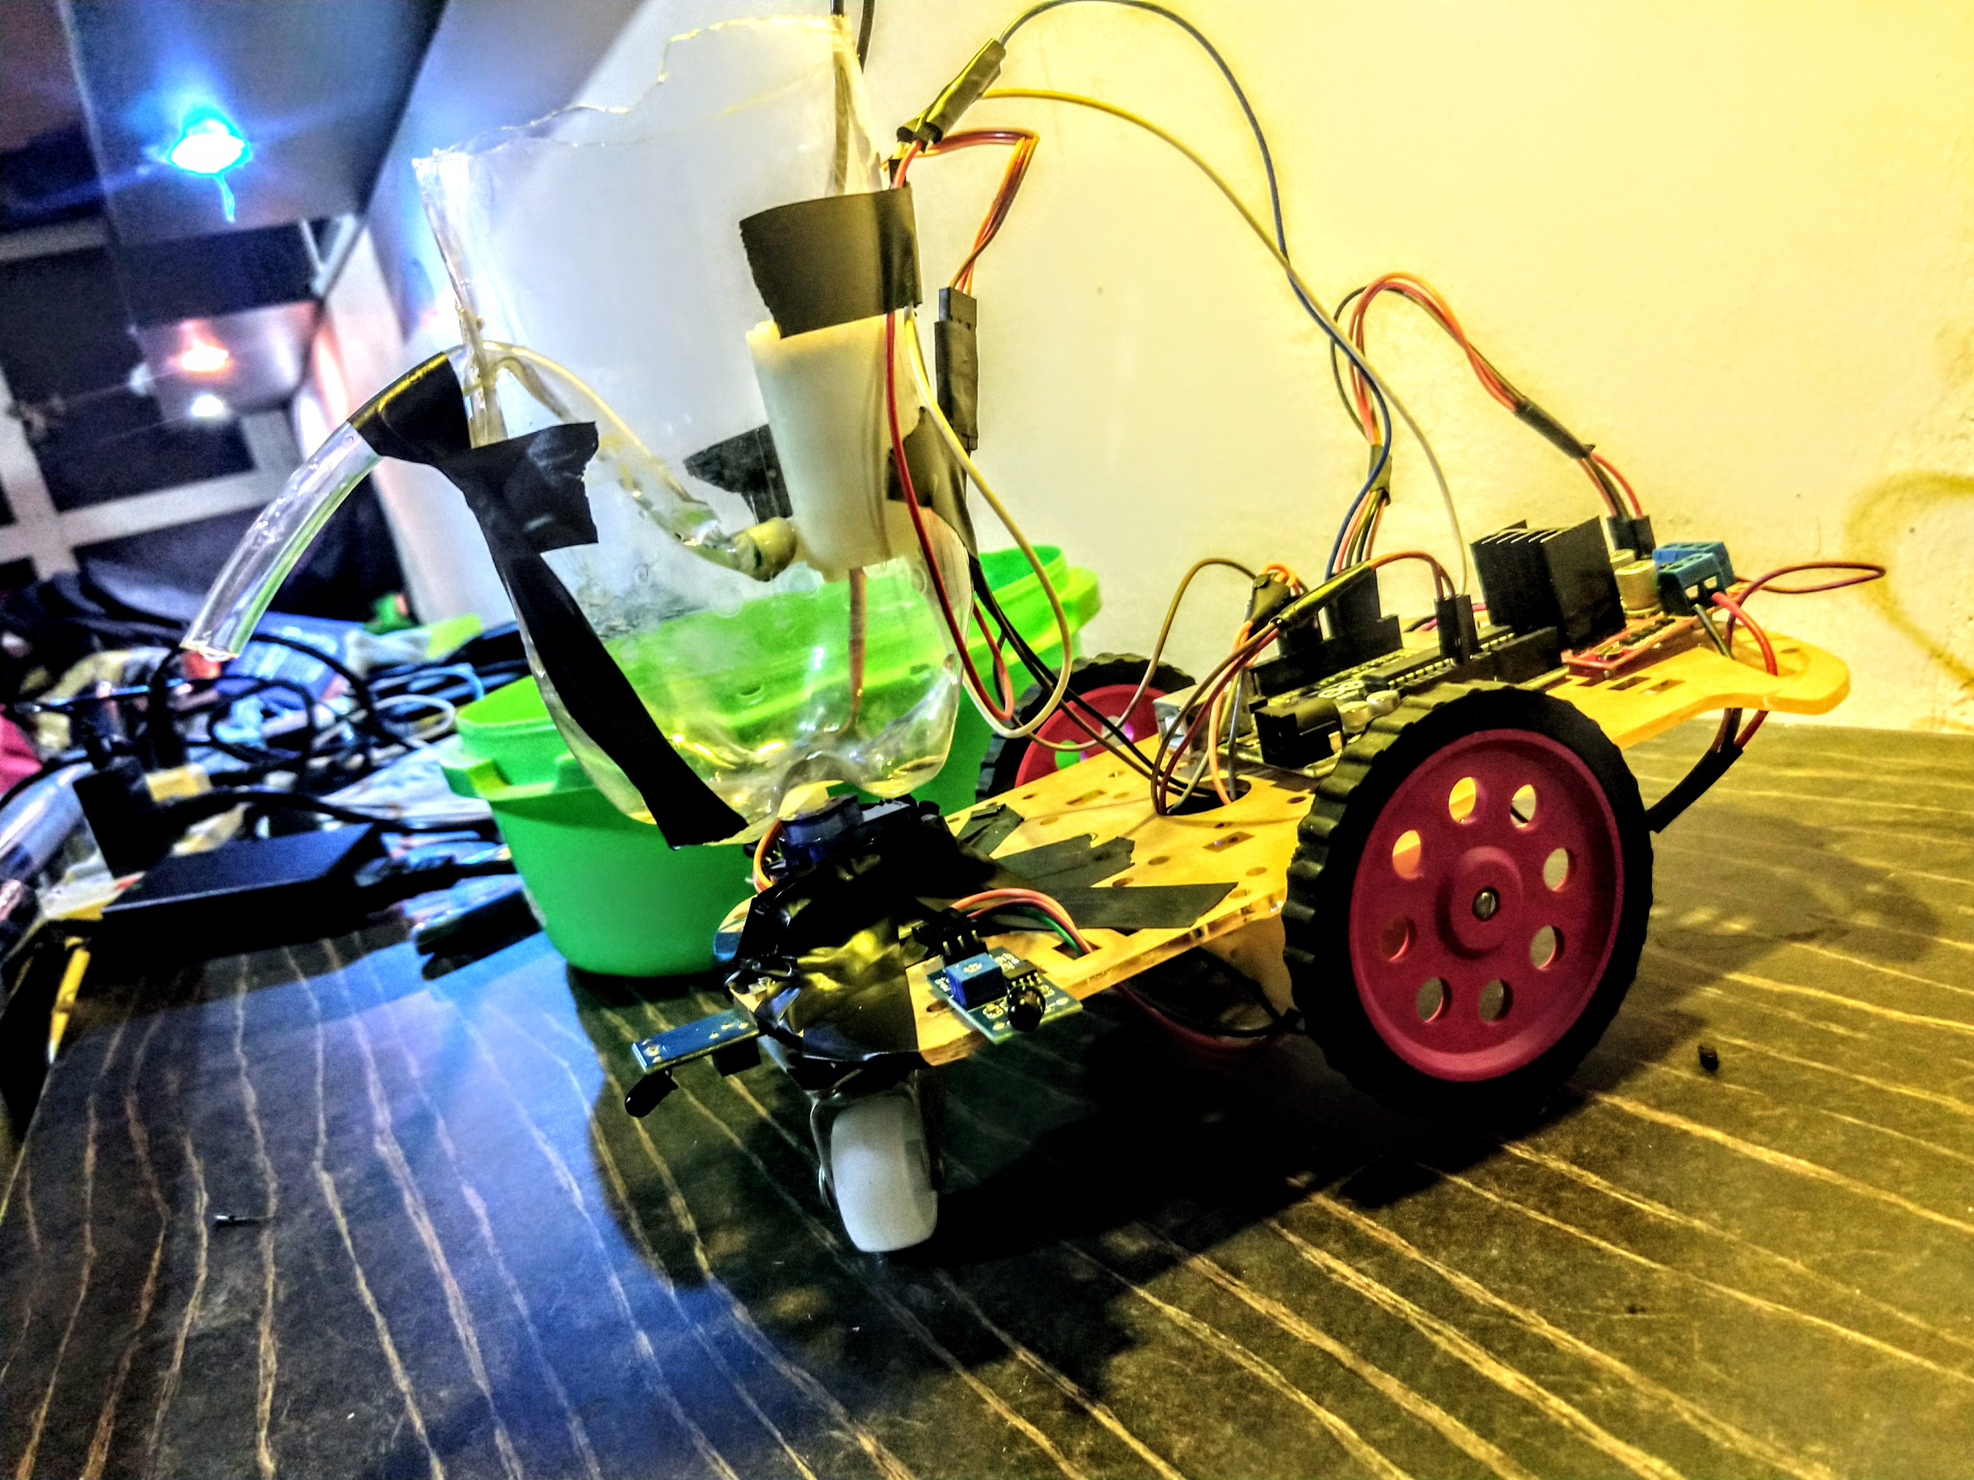
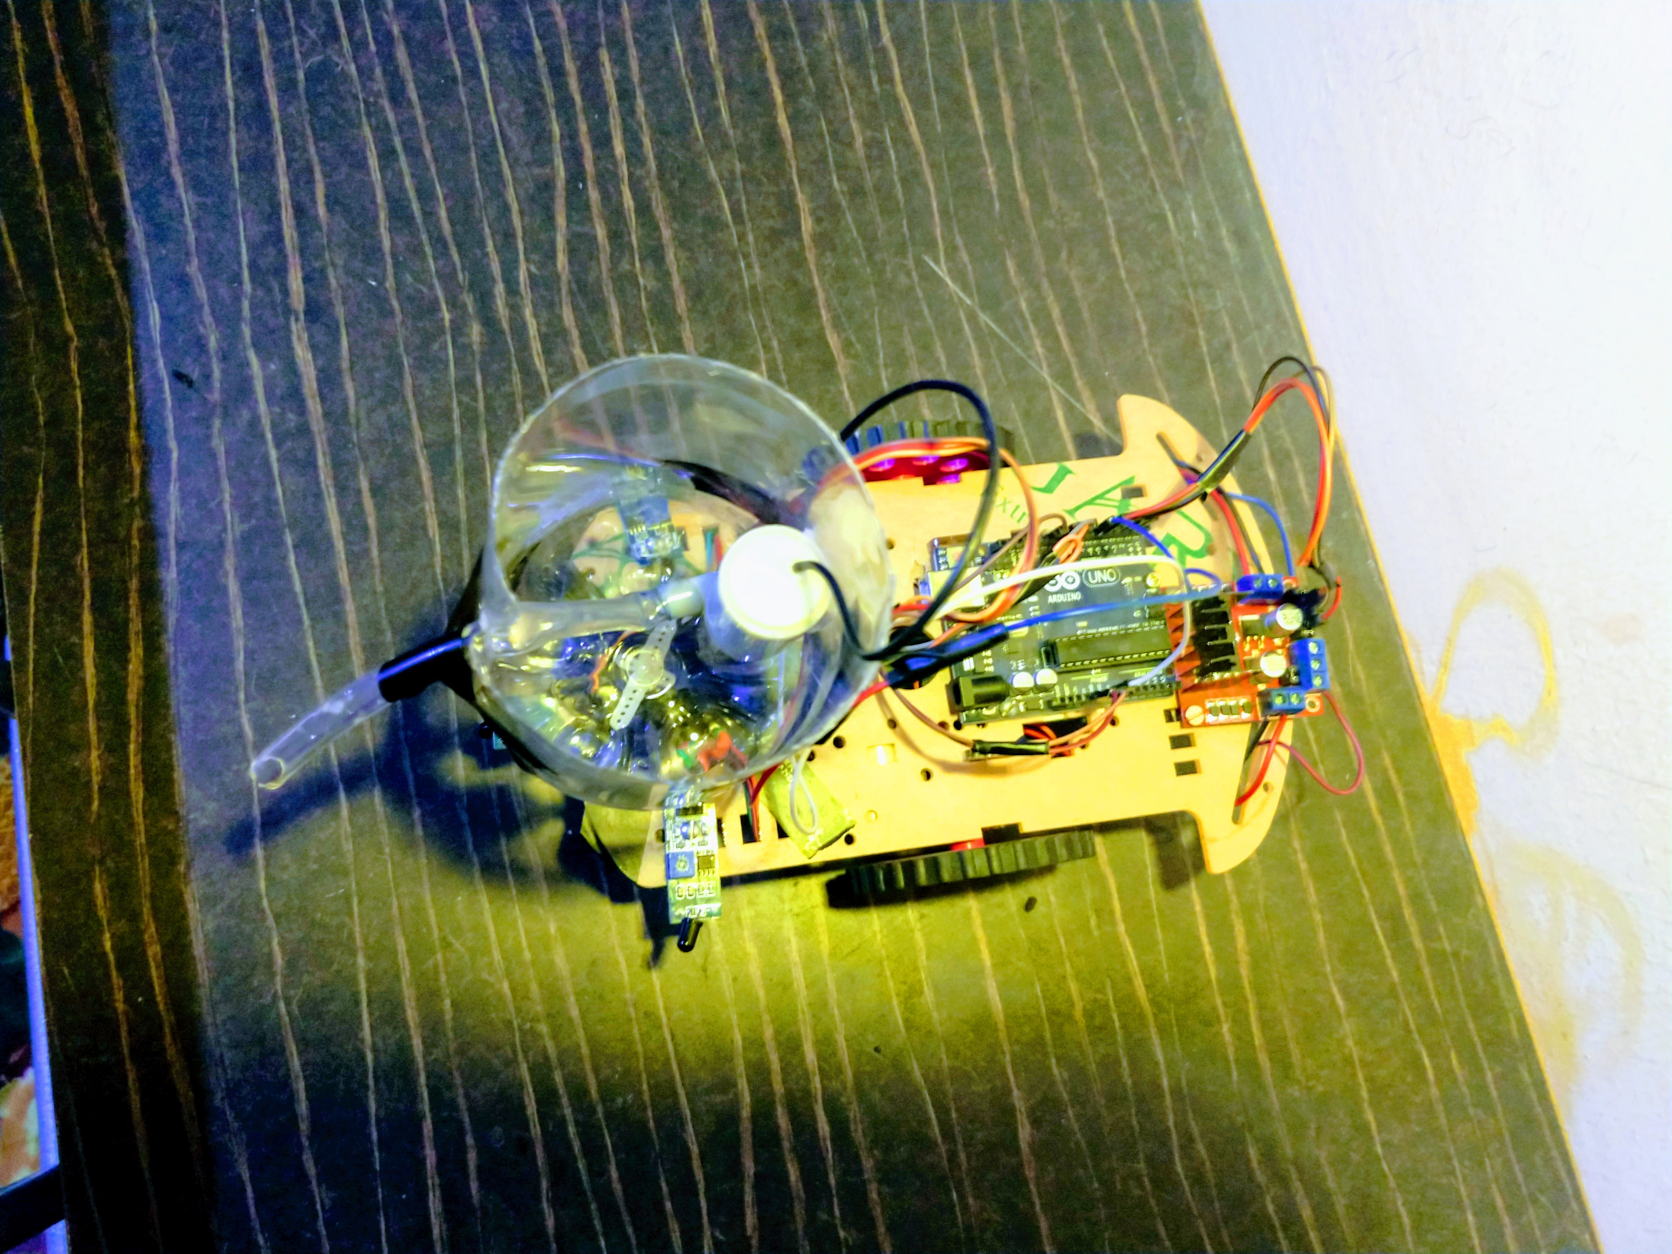
RESULTS :

Slide 20
References:
H. P.Singh, Akanshu Mahajan, N. Sukavanam, Veena Budhraja, Swarn Singh, Amit Kumar and Anadi Vashisht, “Control Of An Autonomous Industrial Fire Fighting Mobile Robot” , DU Journal of Undergraduate Research and Innovation. (Nov-2015).
http://journals.du.ac.in/ugresearch/pdf/J11.pdf
Swati A. Deshmukh, Karishma A. Matte And Rashmi A. Pandhare, “Wireless Fire Fighting Robot”, International Journal For Research In Emerging Science And Technology, Volume-2, Special Issue-1, March-2015.
http://www.issr-journals.org/links/papers.php?journal=ijisr&application=pdf...112-15
Manish Kumbhare, S S Kumbhalkar, Ratnesh Malik. “FIRE FIGHTING ROBOT: AN APPROACH”,Vol.2,Issue.II/March 12, pp.1-4, Indian Streams Research Journal (2014).
https://www.scribd.com/document/140181864/807
Sahil S.Shah, Vaibhav K.Shah, Prithvish Mamtora And Mohit Hapani, “Fire Fighting Robot”, International Journal Of Emerging Trends & Technology In Computer Science (IJETTCS), Volume 2, Issue 4, July – August 2013.
http://www.ijettcs.org/Volume2Issue4/IJETTCS-2013-08-13-084.pdf

Slide 21
THANK YOU
1

